Slide 1

GE100 - Application of Information and Communication Technologies
Lec # 3: Computer and Mobile Devices – Super Computers Cloud Computing and Embedded Computers
Instructor: Alina Maryum

Slide 2
Learning Objectives
Describe the basic categories of computers with examples of each
Define what are embedded computers and what are their uses
Discuss different types of mobile devices
Discuss personal computers and also its types
What are servers and discuss about virtualization
Define mainframe computers and supercomputers
Define cloud computing

Slide 3
Computers to Fit Every Need
Six basic categories of computers, based on size, capability, and price
Embedded computers
Mobile devices
Personal computers
Servers
Mainframe computers
Supercomputers

Slide 4
Embedded Computers
Tiny computer embedded into a product designed to perform specific tasks or functions for that product
Designed for specific tasks and specific products and so cannot be used as general-purpose computers
Often embedded into
Household appliances
Thermostats
Answering machines
Treadmills
Sewing machines
DVD Players
Television

Slide 5
Embedded Computers
Cars also use many embedded computers
To assist with diagnostics
To notify the user of important conditions
Underinflated tire
Oil filter that needs changing
To facilitate the car’s navigational or entertainment systems
To control the use of the airbag and other safety devices
Cameras that alert a driver that a vehicle is in his or her blind spot
Auto-braking systems that engage when a front collision is imminent
Self-driving cars
Large number of embedded computers, lasers, sensors, cameras, and other technology
to enable the car to safely operate without a driver

Slide 6
Mobile Devices
Very small device that has built-in computing or Internet capability
Commonly used to make
Voice and video calls
Send text messages
View Web pages and other documents
Take digital photos
Play games
Download and play music
Watch TV shows
Access calendars
Access social media
Access other tools

Slide 7
Mobile Devices
Mobile devices today include
Conventional mobile phones
Smartphones
Small tablet devices — iPads and Android tablets
Handheld gaming devices
Portable digital media players — the iPod Touch
Smartwatches
Powered by rechargeable batteries
Typically include wireless connectivity to enable the device to connect to Internet

Slide 8
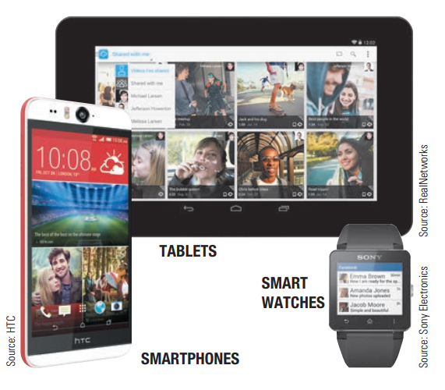
Mobile Devices

Slide 9
Mobile Devices
Today’s mobile devices tend to have small screens and keyboards
Most appropriate for continual access to e-mail and ability to look up information online
Rather than for those individuals wanting general Web browsing or more extensive computing capabilities
Mobile devices can perform Internet searches and other tasks via voice commands
Used to pay for purchases while you are on the go
View virtually any Web content
View and edit documents

Slide 10
Personal Computers (PC)
Small computer designed to be used by one person at a time
Also called a microcomputer
Used by individuals and businesses today
Available in a variety of shapes and sizes
Desktop computers
Portable computers
Thin Clients and internet appliances

Slide 11
1. Desktop Computers
Conventional personal computers that are designed to fit on or next to a desk
Use different types of cases
Tower case — designed to sit vertically, typically on the floor
Regular- or mini-sized case — designed to be placed horizontally on a desk’s surface, all-in-one designed to incorporate the monitor and system unit into a single piece of hardware

Slide 12
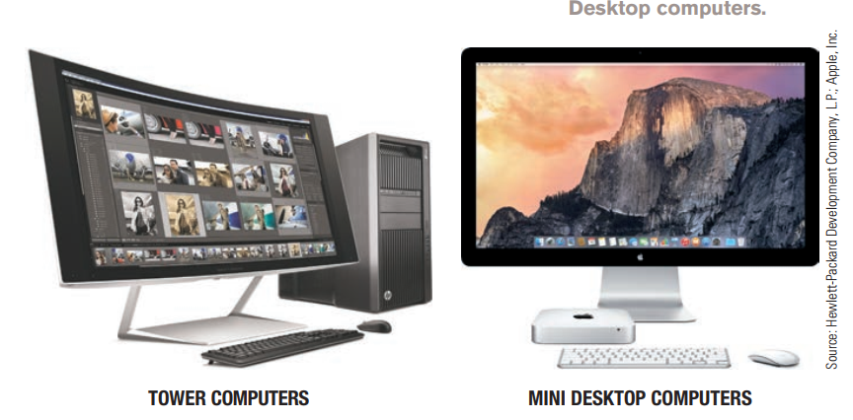
1. Desktop Computers

Slide 13
1. Desktop Computers
Conform to one of two standards or platforms
PC-compatible
Mac
PC-compatible computers
Referred to as Windows PCs or IBM-compatible PCs
Evolved from original IBM PC
First personal computer widely accepted for business use
Made by companies such as Dell, Hewlett-Packard, Acer, Lenovo, and Gateway
Typically run Microsoft Windows operating system
Some may run an alternative operating system such as Linux

Slide 14
1. Desktop Computers
Mac computers
Made by Apple
Use OS X operating system
Workstations
Extra powerful desktop computers
Designed for computer users running graphics, music, film, architecture, science, and other powerful applications
Windows, Linux, and Mac computers typically use different software

Slide 15
2. Portable Computers
Small personal computers designed to be carried around easily
Portability makes them very flexible
Operating Systems
Software Compatibility
Connectivity Options
Usage Scenarios
Enables individuals to use same personal computer
Fully functional computers
Designed to be powered by rechargeable batteries
Available in a variety of configurations

Slide 16
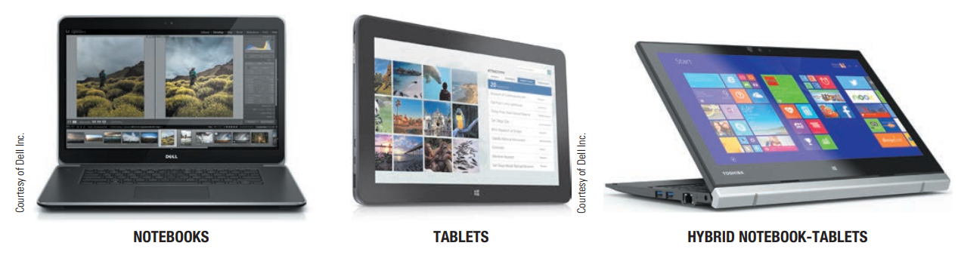
2. Portable Computers

Slide 17
2. Portable Computers
Notebook computers
Fully functioning portable computer that opens to reveal a screen and keyboard
Also called laptop computers
Size of a paper notebook
Typically comparable to desktop computers in features and capabilities
Very thin and very light notebooks — subnotebooks or ultraportable
Ultraportable conforming to Intel’s standards — Ultrabook
Notes:
An Ultrabook is a type of lightweight and thin laptop that typically offers high performance without compromising battery life.

Slide 18
2. Portable Computers
Tablet computers
Typically about size of a notebook computer
Designed to be used with a digital pen/stylus or touch input
Unlike notebooks, don’t have a physical keyboard
Typically use an on-screen or attached keyboard as needed
Convenient in crowded situations, as well as in places where clicking of keyboard would be annoying to others

Slide 19
2. Portable Computers
Hybrid notebook-tablet computers
Also called convertible tablets and 2-in-1 computers
Function as either a notebook or a tablet computer
Have display screen that folds shut to resemble a tablet
Some screens are detachable—designed to separate display part from keyboard part when a tablet is needed

Slide 20
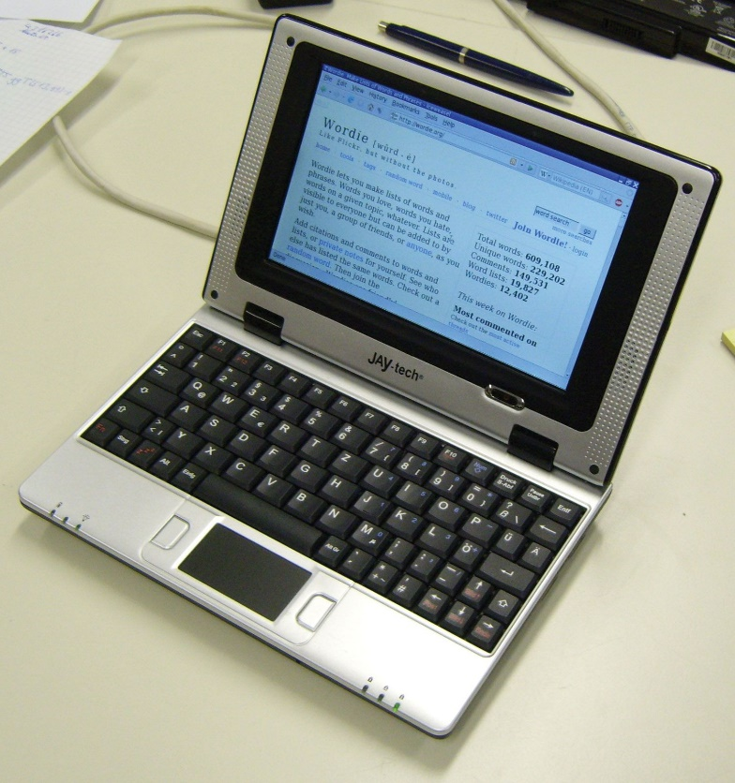
2. Portable Computers
Netbooks
Similar to notebook computers
Smaller as compared to notebook computer
Designed primarily for accessing Internet-based applications and resources
Chromebooks — run the Chrome operating system

Slide 21
3. Thin Clients and Internet Appliances
Most PCs today sold as standalone, self-sufficient units
Equipped with all the necessary hardware and software
Operate independently
Perform input, processing, output, and storage
Although they are often connected to the Internet or another network
Two types of PCs that may be able to perform a limited amount of independent processing but are designed to be used with a network
Thin Clients
Internet Appliances

Slide 22
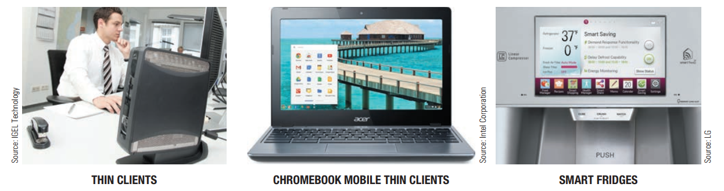
3. Thin Clients and Internet Appliances

Slide 23
3. Thin Clients and Internet Appliances
Thin Client
Personal computer designed to access a network for processing and data storage, instead of performing those tasks locally
Used in conjunction with network
Lower cost, increased security, and easier maintenance
Limited or no local storage
Data stored on a network server
Not able to function as a computer if a network is down
Used in businesses, school computer labs, retail stores, and medical offices
Chromebooks — Mobile thin clients, designed to be used with online apps and storage

Slide 24
Thin Clients and Internet Appliances
Internet Appliance
Specialized network computer designed for Internet access
Smart TVs and smart refrigerators — use apps to deliver news, sports scores, weather, music, and other Web-based information
Gaming consoles – Nintendo Wii, Xbox, and Sony PlayStation— can be used to view Internet content, in addition to their gaming abilities

Slide 25
Servers
Computer used to host programs and data for a network
Also called midrange server, minicomputer, or midrange computer
Typically larger, more powerful, and more expensive than a desktop computer
Usually located in an out-of-the-way place
Serve many users at one time
Users connect via a network with a computer, thin client, or dumb terminal

Slide 26
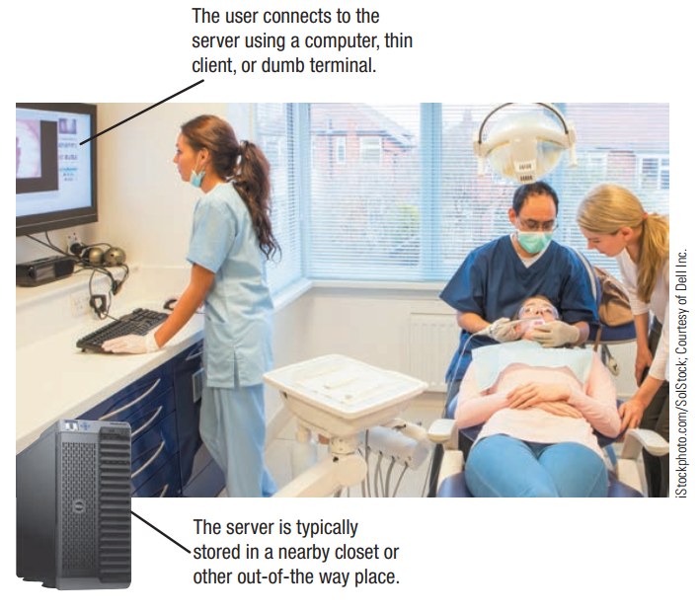
Servers

Slide 27
Servers
Virtualization— creating virtual (rather than actual) versions of a computing resource
Server virtualization
Uses separate server environments
Physically located on the same computer
Function as separate servers
Do not interact with each other
Increased efficiency

Slide 28
Servers
Desktop virtualization
Separates user’s desktop environment from his or her physical computer
Each user’s desktop (stored on a central server) can be delivered to that individual via any authorized device
User interacts with the virtual desktop in the same way he or she would interact with a physical desktop
Adds flexibility to where and how each worker performs daily tasks
Also be used in other computing areas, such as networking and storage

Slide 29
Mainframe Computers
Powerful computer used by many large organizations to manage large amounts of centralized data
Standard choice for hospitals, universities, large businesses, banks, government offices
Connected to the rest of the company computers via a network
Larger, more expensive, and more powerful than servers
Usually operates 24 hours a day
Also called high-end servers or enterprise-class servers

Slide 30
Mainframe Computers
The issue facing businesses today — high cost of electricity to power and cool the mainframes, servers, and personal computers
Making the computers located in a business—particularly mainframes and servers—more energy efficient is a high priority
Virtualization is often used today to utilize a company’s mainframes more efficiently
Can handle new and emerging needs
Having computational power to process data from smart meters and other new technology
Having the ability to run mobile and social networking applications
Notes:
Smart meters are advanced devices that measure energy consumption in real time and communicate this information back to the utility provider.

Slide 31
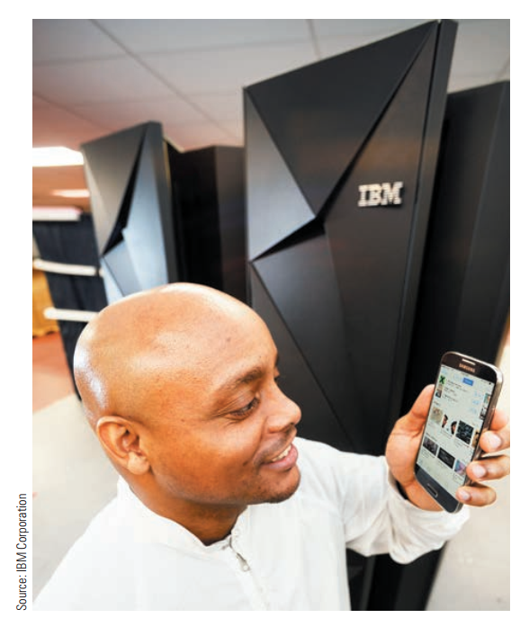
Mainframe Computers
Mainframe is designed to process mobile data—it supports 8,000 virtual servers and can process 2.5 billion transactions per day

Slide 32
Supercomputers
Fastest, most expensive, most powerful type of computer
Generally run one program at a time, as fast as possible
Can cost several million dollars each
Tend to be very large and contain a large number of CPUs
Host extremely complex Web sites (such as search sites and social networking sites)
Three-dimensional applications (such as 3D medical imaging, 3D image projections, and 3D architectural modelling)

Slide 33
Supercomputers
Titan is one of the fastest computers in the world.
Occupies 4,352 square feet of floor space
Contains more than 300,000 processors
Installed at U.S. Department of Energy Oak Ridge National Laboratory
Used for scientific research, including climate change and astrophysics
Speed is expected to give researchers unparalleled accuracy in their simulations
Facilitate faster research breakthroughs
Peak speed of 27,000 trillion calculations per second

Slide 34
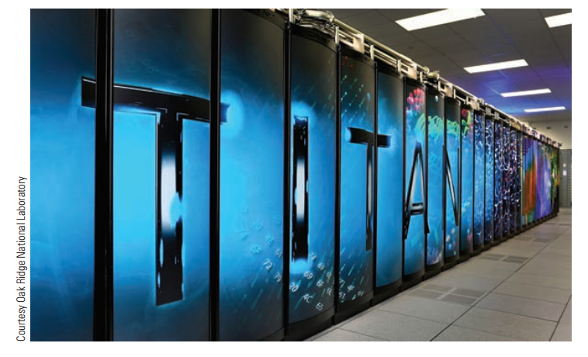
Supercomputers

Slide 35
Cloud Computing
Accessing data, applications, and other resources stored on computers
Available via the Internet
In a “cloud” of computers
Rather than on users’ computers
Can access Web-based software and apps
Store and retrieve data via a cloud storage provider
Print documents to a cloud printer located anywhere in the world
Resources are available on demand, whenever the user needs them
Notes:
cloud computing is the delivery of computing services—including servers, storage, databases, networking, software, analytics, and intelligence—over the internet (“the cloud”) to offer faster innovation, flexible resources, and economies of scale.

Slide 36
Cloud Computing
Advantages
Ability to access data from anywhere the user has an active Internet connection
Because data is stored online instead of on the user’s device, the data is safe if that device is lost, stolen, or damaged.
Disadvantages
No or reduced functionality without an Internet connection
Potentially high expense related to data transfer for companies and individuals using high-bandwidth applications.

Slide 37
Cloud Computing
Chromebooks
Google's Chrome OS operating system
simple, lightweight, and highly focused on web-based applications and cloud computing
Users of Chromebooks are full-time cloud users
Chromebooks are designed to be used with
Online Google Apps such as Google Docs, Gmail, and Google Play Music
Documents, mail, photos, music, and more are stored in the cloud

Slide 38
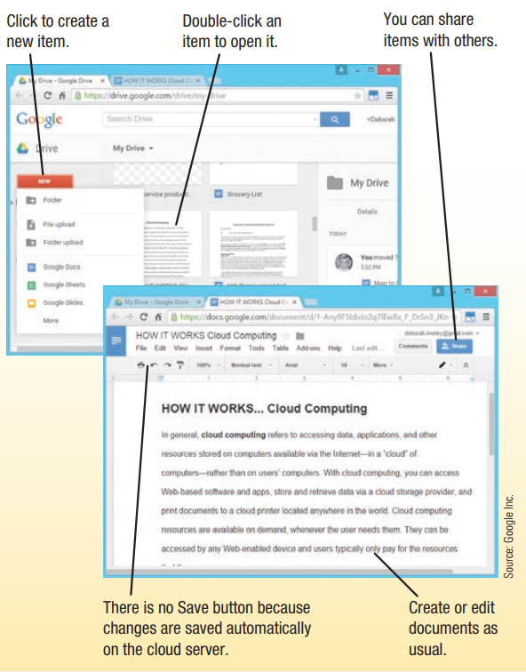
Cloud Computing

Slide 39
Summary
Embedded computers
Mobile devices
Personal computers
Servers
Mainframe Computers
Supercomputers
Cloud Computing

